Slide 1



UNIVERSITY INSTITUTE OF ENGINEERING
COMPUTER SCIENCE ENGINEERING
Bachelor of Engineering
Cloud Computing(CST-411)
Prepared By: Ms. Himanshu(E11818)
Topic: Service Models, Features of SaaS, PaaS and IaaS
DISCOVER . LEARN . EMPOWER

Slide 2
Overview
Introduction To Cloud
Brief intro Cloud Computing
Basic Concepts
Deployment Model
Service Models
IaaS
Benefits and Issues of IaaS
PaaS
Benefits and Issues of PaaS
SaaS
Benefits and Issues of SaaS

Slide 3
Cloud Computing
In Simplest terms, cloud computing means storing and accessing the data and programs on remote servers that are hosted on internet instead of computer’s hard drive or local server.
Cloud computing is also referred as Internet based computing.
In other words, we can say that Cloud computing means on demand delivery of IT resources via the internet with pay-as-you-go pricing. It provides a solution of IT infrastructure in low cost

Slide 4
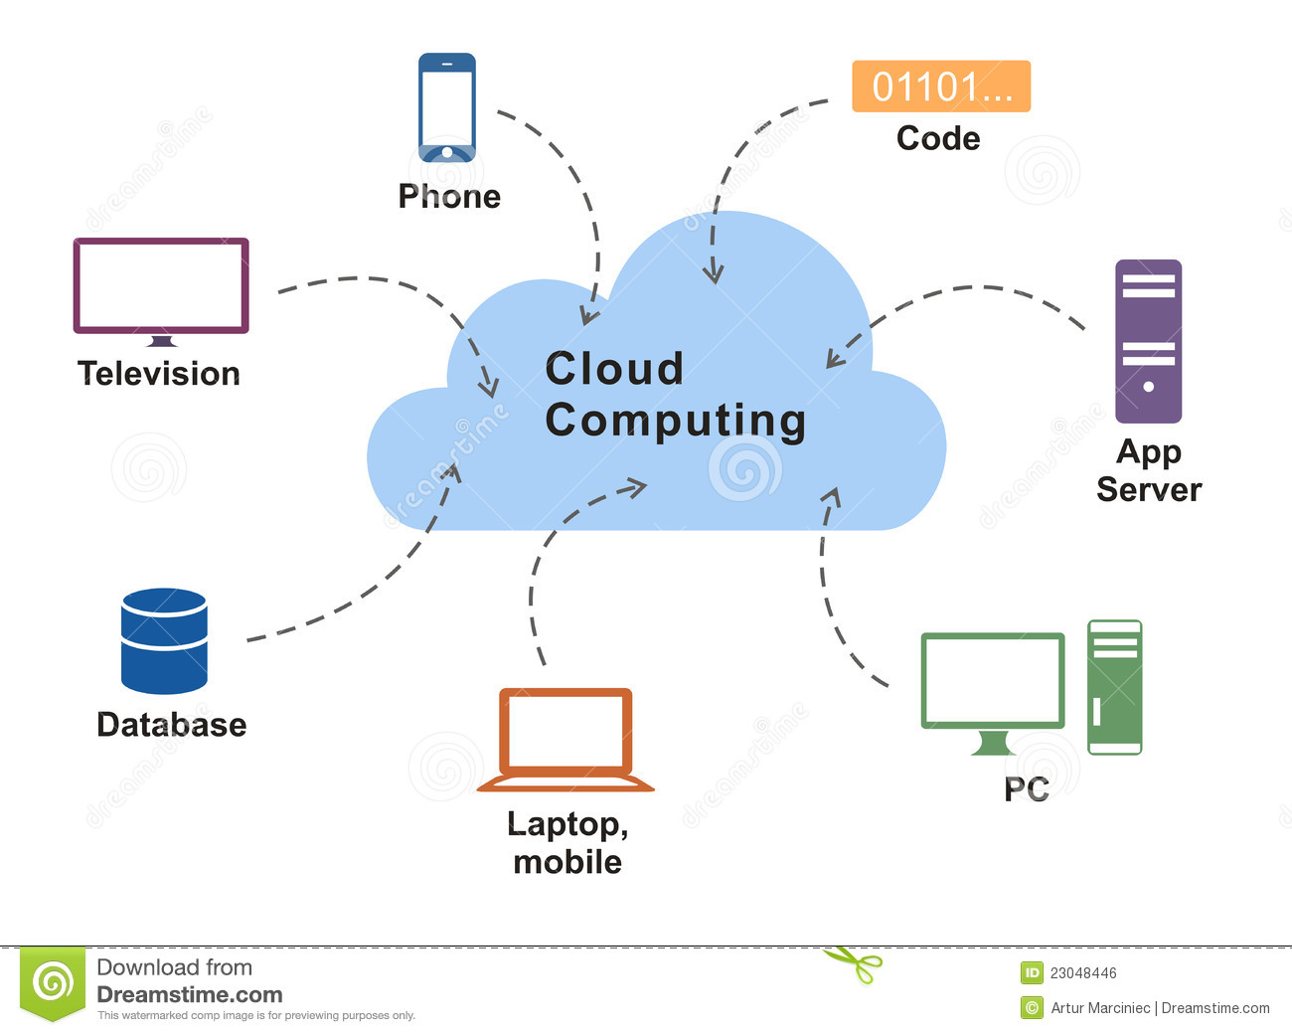

Slide 5
What is Cloud Computing ?
Cloud computing is a virtualization-based technology .
It allows us to create, configure, and customize applications via an internet connection.
The data can be anything such as files, images, documents, audio, video, and more.
There are the following operations that we can do using cloud computing:
Developing new applications and services
Storage, back up, and recovery of data
Hosting blogs and websites
Delivery of software on demand
Analysis of data
Streaming videos and audios

Slide 6
Why need Cloud Computing?
Small as well as large IT companies, follow the traditional methods to provide the IT infrastructure.
That means for any IT company, we need a Server Room that is the basic need of IT companies.
In that server room, there should be a database server, mail server, networking, firewalls, routers, modem.
Switches To establish such IT infrastructure, we need to spend lots of money.

Slide 7
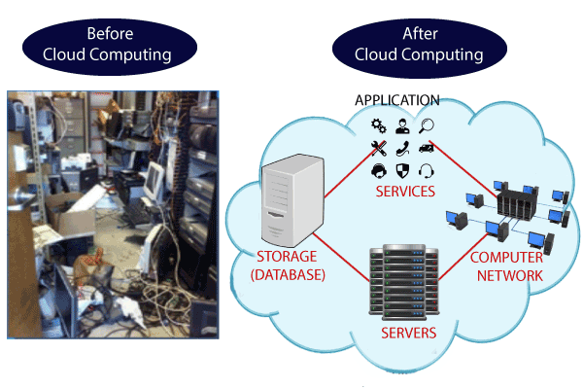
Need Of Cloud Computing

Slide 8
Basic Concept
There are certain Services And models working behind the seen making cloud computing feasible and accessible to end users.
Following are the working models of cloud computing:
Deployment Model
Service Model

Slide 9
Cloud Deployment Model
Deployment model defines the type of access to the cloud: that is how the cloud is located?
Cloud can have any of four type of access :
Public Cloud
Private Cloud
Hybrid Cloud
Community Cloud

Slide 10
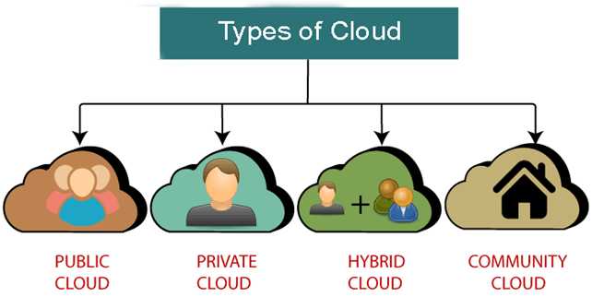
Cloud Deployment Model

Slide 11

Service Models

Slide 12

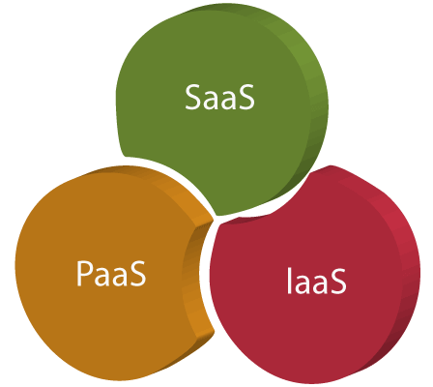
Service Models
Service Models are the reference models on which the Cloud Computing is based. These can be categorized into three basic service models as listed below:
1. Infrastructure as a Service (IaaS)
2. Platform as a Service (PaaS)
3. Software as a Service (SaaS)

Slide 13
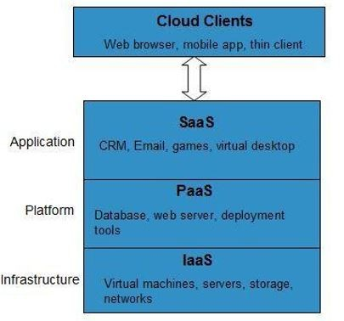
The Infrastructure as a Service (IaaS) is the most basic level of service.
Each of the service models make use of the underlying service model, i.e., each inherits the security and management mechanism from the underlying model, as shown in the following diagram:

Slide 14
IaaS
Infrastructure as a service (IaaS) is a service model that delivers computer infrastructure on an outsourced basis to support various operations.
It is also known as Hardware as a Service (HaaS).
IaaS customers pay on a per-user basis, typically by the hour, week, or month.

Slide 15
Advantages of IaaS:
Cost-Effective
Website hosting
Security
Maintenance

Slide 16
Providing companies
The various companies providing Infrastructure as a service are :
Amazon web services,
Blue stack
IBM,
Open stack
Rackspace, and
VMware

Slide 17
Issues of laaS
Limited control over infrastructure
Security concerns
Limited access

Slide 18
Infrastructure as a Service (IaaS)
IaaS is the delivery of technology infrastructure as an on demand scalable service.
IaaS provides access to fundamental resources such as physical machines, virtual machines, virtual storage, etc.
Apart from these resources, the IaaS also offers: •Virtual machine disk storage
Virtual local area network (VLANs)
Load balancers
IP addresses
Software bundles

Slide 19

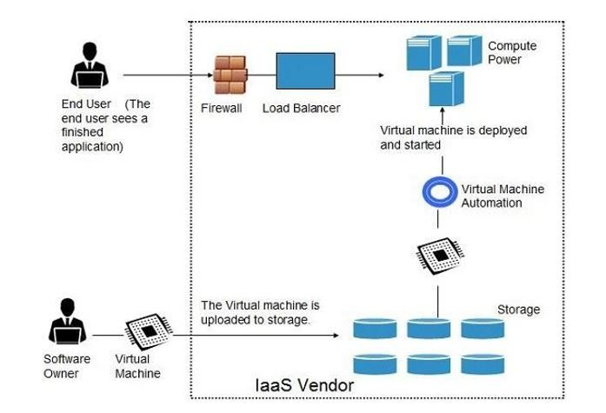
All of the above resources are made available to end user via server virtualization.
Resources are accessed by the customers as if they own them.

Slide 20
Benefits :
Full Control of the computing resources through hypervisor
Administrative Access to VMs.
Flexible and Efficient renting of Computer Hardware.
Portability, Interoperability with Legacy Applications.
Issues :
Compatibility with legacy security vulnerabilities
Virtual machine sprawl
Data erase practices
Robustness of VM-level isolation

Slide 21
PaaS
PaaS is a category of cloud computing that provides a platform and environment to allow developers to build applications and services over the internet.
A PaaS provider hosts the hardware and software on its own infrastructure.
As a result, PaaS frees users from having to install in-house hardware and software to develop or run a new application.
Thus, the development and deployment of the application take place independent of the hardware.

Slide 22
Advantages of PaaS
Simple and convenient for users
Cost-Effective
Efficiently managing the lifecycle
Efficiency

Slide 23
The various companies providing Platform as a service are :
Amazon Web services Elastic Beanstalk,
Salesforce,
Windows Azure,
Google App Engine,
cloud Bees and IBM smart cloud.

Slide 24
Issues of PaaS
Limited control over infrastructure
Dependence on the provider
Limited flexibility

Slide 25
Platform as a Service (PaaS)
PaaS provides the runtime environment for applications, development & deployment tools, etc.
Google's App Engine, Force.com are examples of PaaS offering vendors.
Developer may log on to these websites and use the built-in API to create web-based applications.

Slide 26
Benefits :
Lower administrative overhead
Lower total cost of ownership
Scalable solutions
More current system software
Issues :
Lack of portability between PaaS clouds
Event based processor scheduling
Security engineering of PaaS applications

Slide 27
SaaS
SAAS is a way of delivering services and applications over the Internet.
SaaS provides a complete software solution that you purchase on a pay-as-you-go basis from a cloud service provider.
Most SaaS applications can be run directly from a web browser without any downloads or installations required.
The SaaS applications are sometimes called Web-based software, on-demand software, or hosted software.

Slide 28
Software as a Service (SaaS)
SaaS model allows to use software applications as a service to end users.
Software that is deployed on a hosted service and is accessible via Internet.
There are several SaaS applications, some of them are listed below:
Billing and Invoicing System
Customer Relationship Management (CRM) applications
Help Desk Applications
Human Resource (HR) Solutions

Slide 29

Benefits of SaaS
Cost-Effective
Reduced time
Accessibility
Automatic updates
Scalability

Slide 30
The various companies providing Software as a service are
Cloud9 Analytics,
Salesforce.com,
Cloud Switch,
Microsoft Office 365,
Big Commerce.

Slide 31
Issues of SaaS
Limited customization
Dependence on internet connectivity
Security concerns
Limited control over data

Slide 32
THANK YOU

